Slide 1
Autoantibody Prediction Models for Type 1 Diabetes
Ethan de Villiers

Slide 2
Models
Clinical features = Age + BMI
Clinical features + GAD
Clinical features + ZNT8
IA2 model changed
Produce similar model weightings
Warning: Model was calibrated for IA2
Clinical features + Antibodies

Slide 3
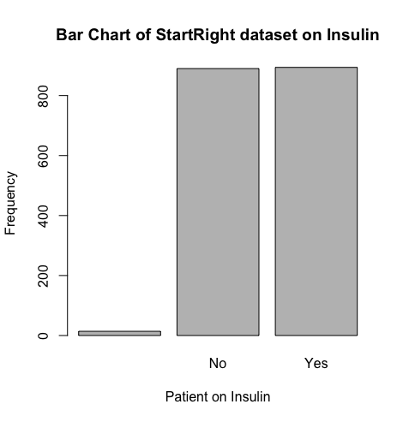
StartRight Dataset
1798 patient’s medical data
>= 18 years old
894 on Insulin
Dataset is not representative of general population
~49% prevalence of T1D in sample
About 8% in UK Population¹
¹ Diabetes UK (2019) Us, diabetes and a lot of facts and stats. Diabetes UK.

Slide 4
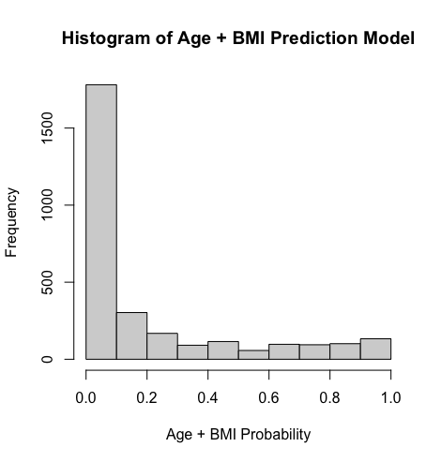
Clinical Features
Relatively poor discrimination
61.1% of 1772 in bottom decile
26 patients excluded
= Low risk of Diabetes Type 1
Only 20.4% predicted over 60% risk of T1D
263 people / 894 on insulin
= 29.4% accuracy
Notes:
1772
[1073, 178, 98, 56, 68, 36, 56, 63, 61, 83]
[0.6055304740406321, 0.10045146726862303, 0.055304740406320545, 0.03160270880361174, 0.03837471783295711, 0.020316027088036117, 0.03160270880361174, 0.035553047404063204, 0.034424379232505645, 0.04683972911963882]

Slide 5
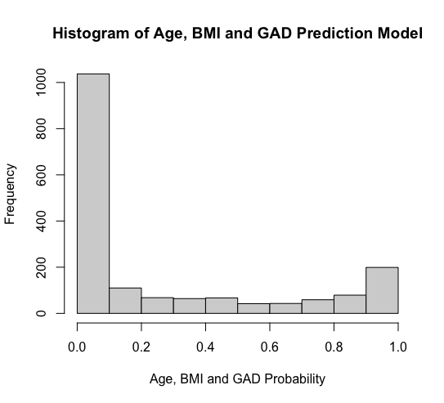
Clin + GAD
Improving discrimination
58.7% of 1768 in bottom decile
30 patients excluded
= Low risk of Diabetes Type 1
Only 21.6% predicted over 60% risk of T1D
380 people / 894 on insulin
= 42.5% accuracy
Notes:
[1037, 110, 68, 64, 67, 42, 43, 59, 79, 199]
[0.5865384615384616, 0.06221719457013575, 0.038461538461538464, 0.03619909502262444, 0.03789592760180995, 0.023755656108597284, 0.024321266968325792, 0.0333710407239819, 0.04468325791855204, 0.11255656108597285]

Slide 6
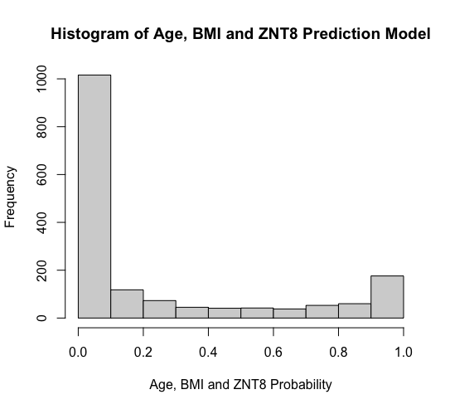
Clin + ZNT8
More negatively favored discrimination
61.1% of 1662 in bottom decile
136 patients excluded
Only 19.7% predicted over 60% risk of T1D
327 people / 894 on insulin
= 36.6% accuracy
Notes:
1662
[1016, 118, 73, 45, 41, 42, 38, 53, 60, 176]
[0.6113116726835138, 0.07099879663056559, 0.043922984356197355, 0.02707581227436823, 0.0246690734055355, 0.02527075812274368, 0.02286401925391095, 0.031889290012033694, 0.036101083032490974, 0.10589651022864019]

Slide 7
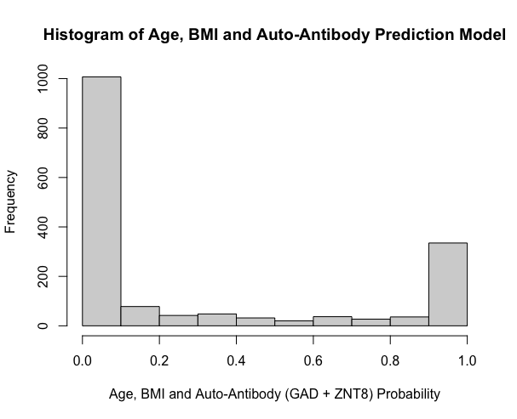
Clin + Both
More positively favored discrimination
61.1% of 1662 in bottom decile
136 patients excluded
Only 26.2% predicted over 60% risk of T1D
435 people / 894 on insulin
= 48.7% accuracy
Notes:
1662
[1007, 78, 42, 48, 32, 20, 37, 27, 36, 335]
[0.6058965102286402, 0.04693140794223827, 0.02527075812274368, 0.02888086642599278, 0.019253910950661854, 0.012033694344163659, 0.022262334536702767, 0.016245487364620937, 0.021660649819494584, 0.20156438026474127]

Slide 8
Comparing Models
(%) | Decile 1 | Decile 2 | Decile 3 | Decile 4 | Decile 5 | Decile 6 | Decile 7 | Decile 8 | Decile 9 | Decile 10
Clin | 61.1 | 11.3 | 6.9 | 4.6 | 5.2 | 3.4 | 4.6 | 4.9 | 4.8 | 6.1
Clin GAD | 58.7 | 6.2 | 3.8 | 3.6 | 3.8 | 2.4 | 2.4 | 3.3 | 4.7 | 11.2
Clin ZNT8 | 61.1 | 7.1 | 4.4 | 2.7 | 2.5 | 2.5 | 2.3 | 3.2 | 3.6 | 10.6
Clin both | 60.6 | 4.7 | 2.5 | 2.9 | 1.9 | 1.2 | 2.2 | 1.6 | 2.2 | 20.2
(%) | Clin | Clin GAD | Clin ZNT8 | Clin both
Accuracy | 29.4 | 42.5 | 36.6 | 48.7
Notes:
1662
[1007, 78, 42, 48, 32, 20, 37, 27, 36, 335]
[0.6058965102286402, 0.04693140794223827, 0.02527075812274368, 0.02888086642599278, 0.019253910950661854, 0.012033694344163659, 0.022262334536702767, 0.016245487364620937, 0.021660649819494584, 0.20156438026474127]

Slide 9
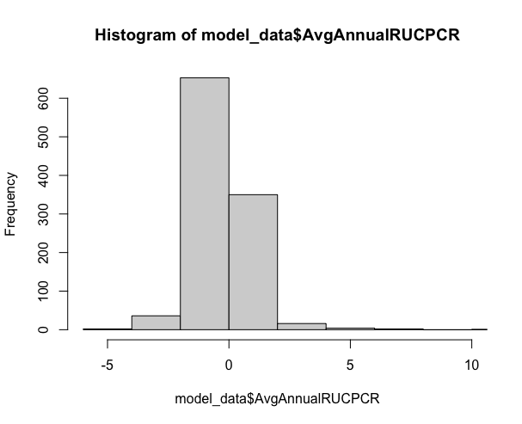

UCPCR Average Loss
Calculated as:
V2 – V1 /2
V3 – V2 /2
$\frac{\text{(}\text{V}\text{2 – }\text{V}\text{1 /2) + (}\text{V}\text{3 – }\text{V}\text{2 /2) }}{2}$

Slide 10
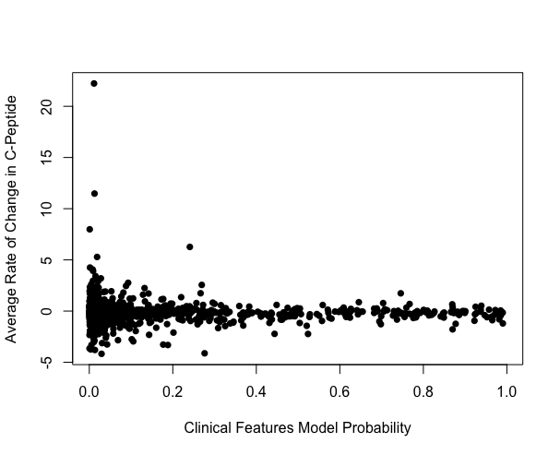
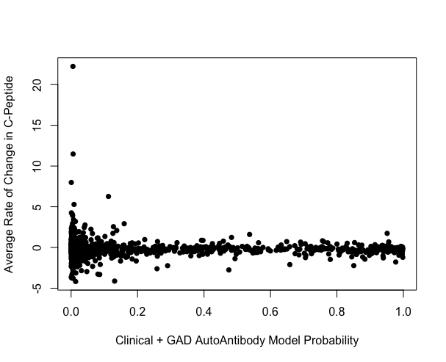
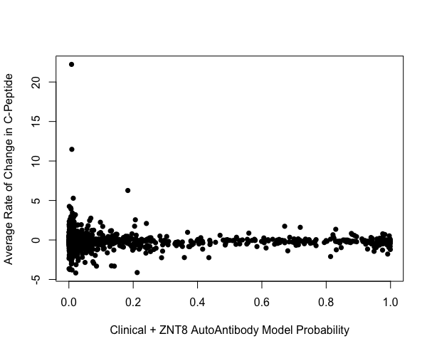
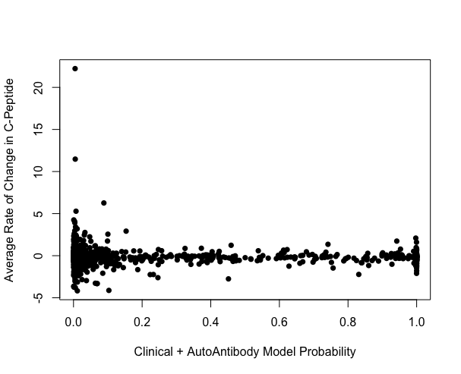
Models vs Avg Change in UCPCR

